Slide 1
Novartis Oncology Template
Subtitle for Presentation Cover Slide
Presenter, Job Title | Place, Date

Slide 2
Agenda
Section 1
Section 2
Section 3
Section 4
Section 5

Slide 3
Agenda
Section 1
Section 2
Section 3
Section 4
Section 5

Slide 4
Agenda
Section 1
Section 2
Section 3
Section 4
Section 5

Slide 5

<number> | Presentation Title | Presenter Name | Date | Subject | Business Use Only

Slide 6
in USD m
<number> | Presentation Title | Presenter Name | Date | Subject | Business Use Only

Slide 7
Org Chart Title
<number> | Presentation Title | Presenter Name | Date | Subject | Business Use Only

Slide 8
Callout
Callout
Callout
Callout
Callout
Callout
<number> | Presentation Title | Presenter Name | Date | Subject | Business Use Only

Slide 9
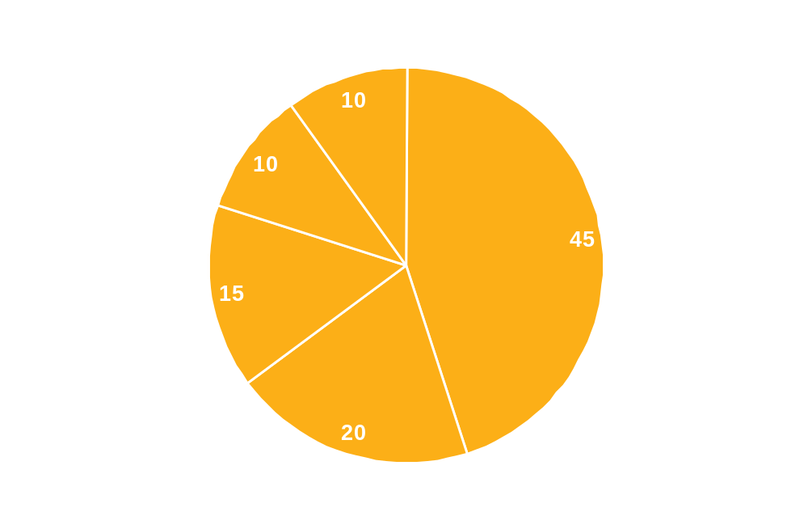
Chart Title
xxx
xxx
xxx
xxx
xxx
<number> | Presentation Title | Presenter Name | Date | Subject | Business Use Only

Slide 10
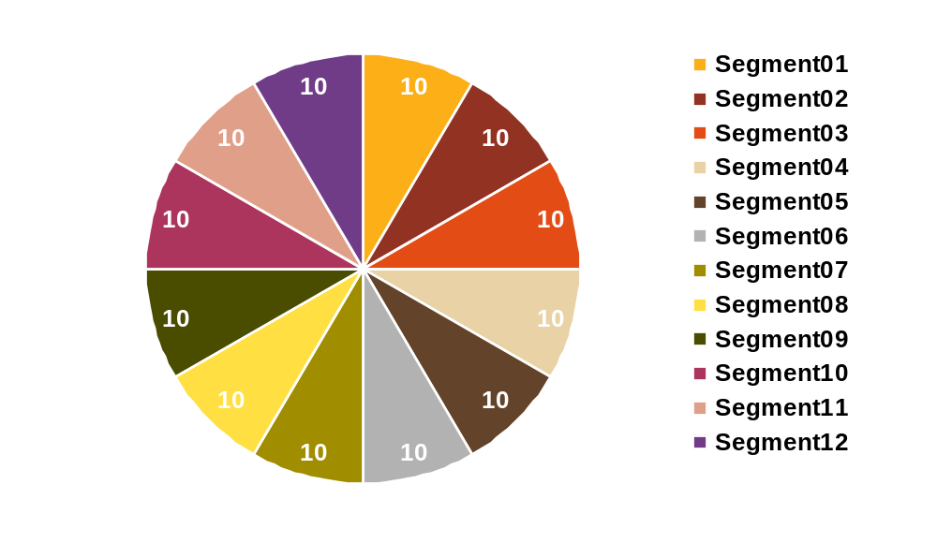
Chart Title
<number> | Presentation Title | Presenter Name | Date | Subject | Business Use Only

Slide 11
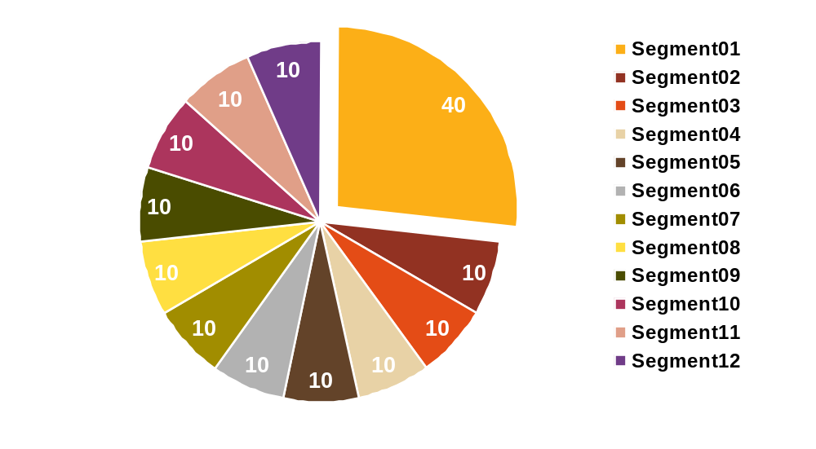
Chart Title
<number> | Presentation Title | Presenter Name | Date | Subject | Business Use Only

Slide 12
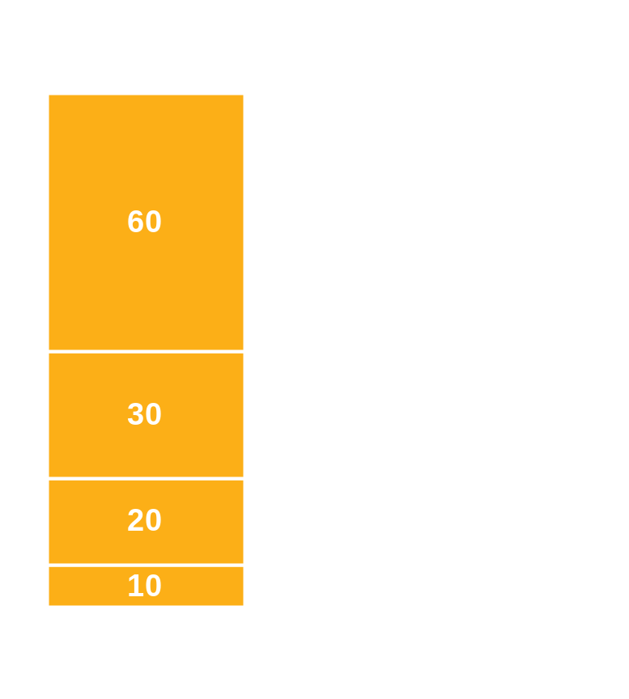
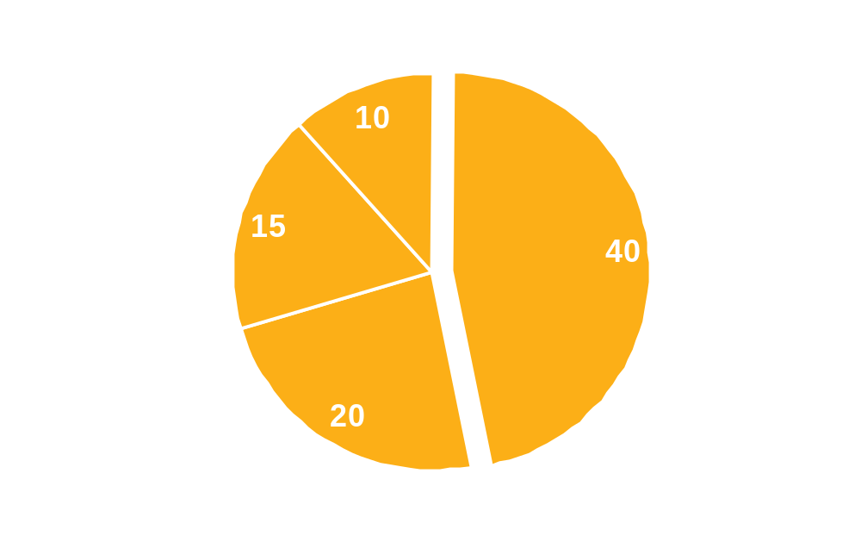
Chart Title
XXX
100%
xxx
xxx
xxx
xxx
xxx
xxx
xxx
xxx
<number> | Presentation Title | Presenter Name | Date | Subject | Business Use Only

Slide 13
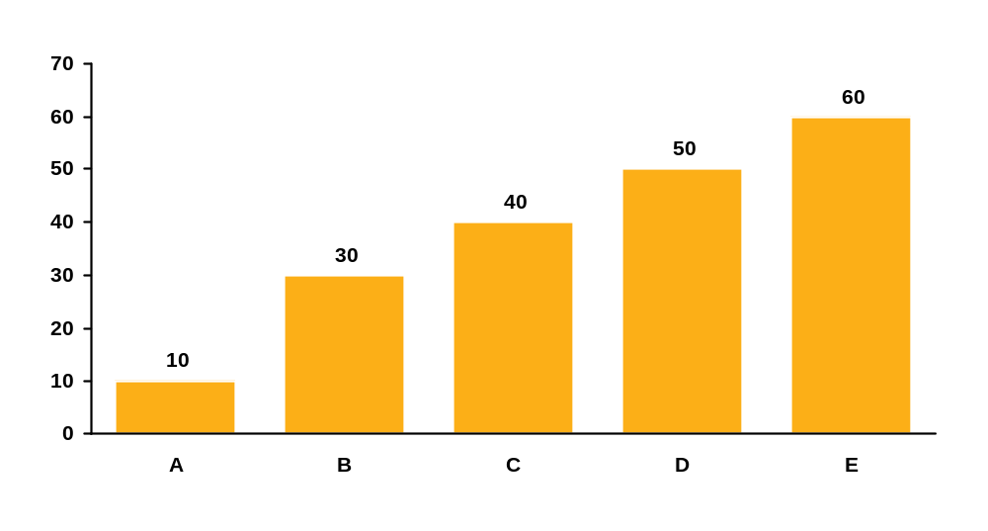
Chart Title
<number> | Presentation Title | Presenter Name | Date | Subject | Business Use Only

Slide 14
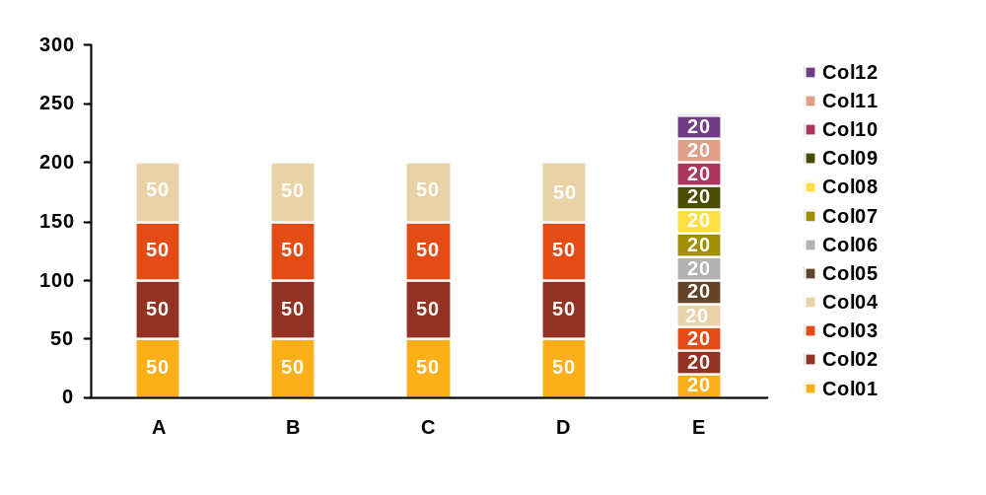
Chart Title
xxx
xxx
xxx
xxx
xxx
<number> | Presentation Title | Presenter Name | Date | Subject | Business Use Only

Slide 15
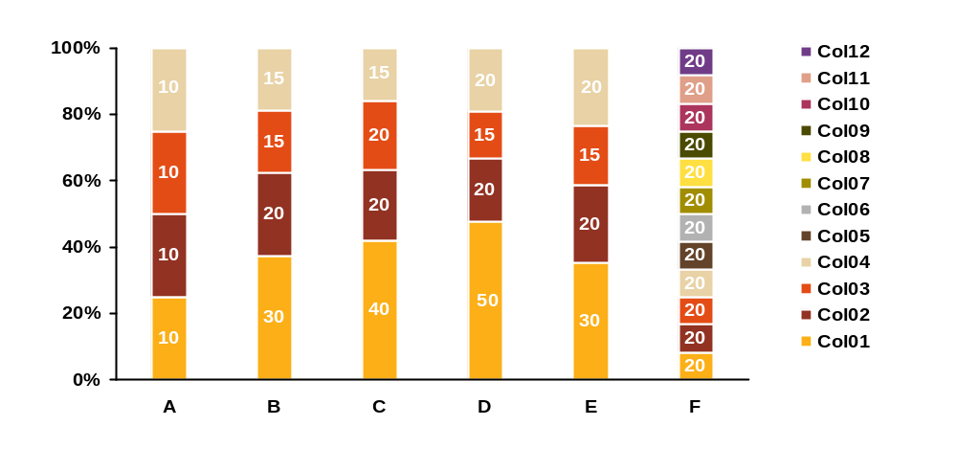
Chart Title
Chart Title
<number> | Presentation Title | Presenter Name | Date | Subject | Business Use Only

Slide 16
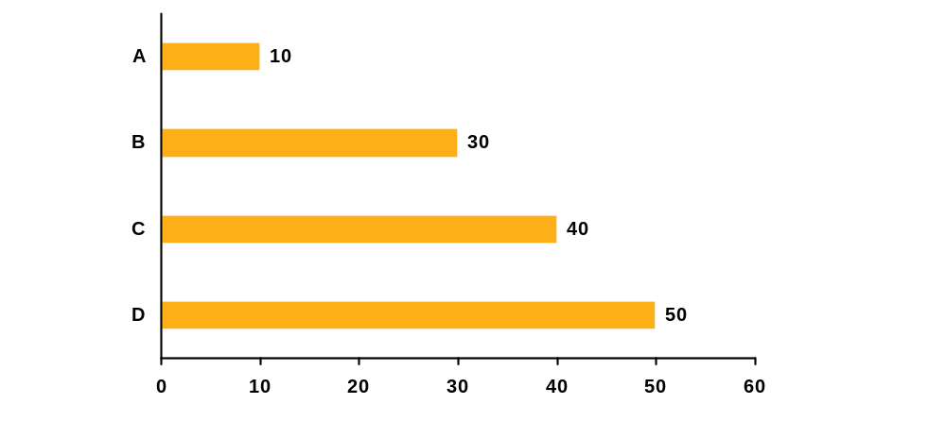
Chart Title
<number> | Presentation Title | Presenter Name | Date | Subject | Business Use Only

Slide 17
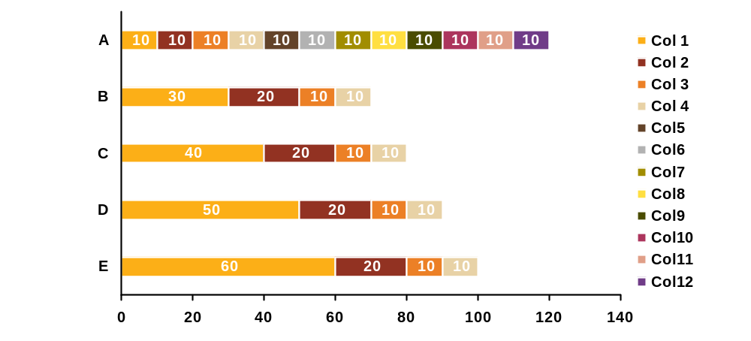
Chart Title
xxx
xxx
xxx
xxx
xxx
<number> | Presentation Title | Presenter Name | Date | Subject | Business Use Only

Slide 18
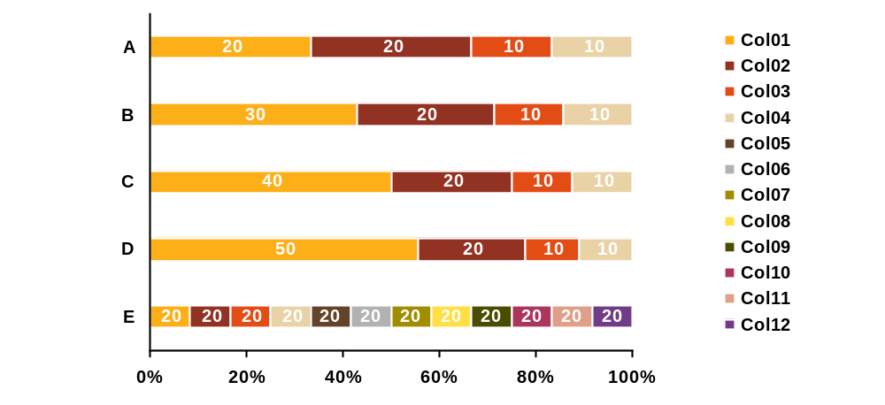
Chart Title
100%
xxx
xxx
xxx
xxx
xxx
<number> | Presentation Title | Presenter Name | Date | Subject | Business Use Only

Slide 19
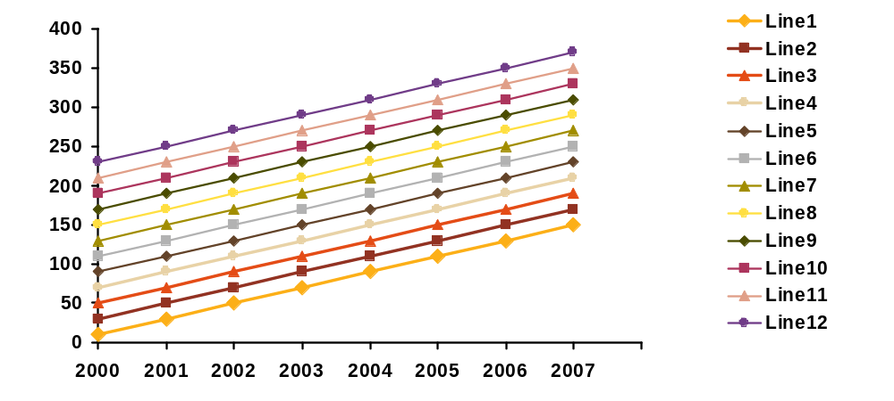
Chart Title
<number> | Presentation Title | Presenter Name | Date | Subject | Business Use Only

Slide 20
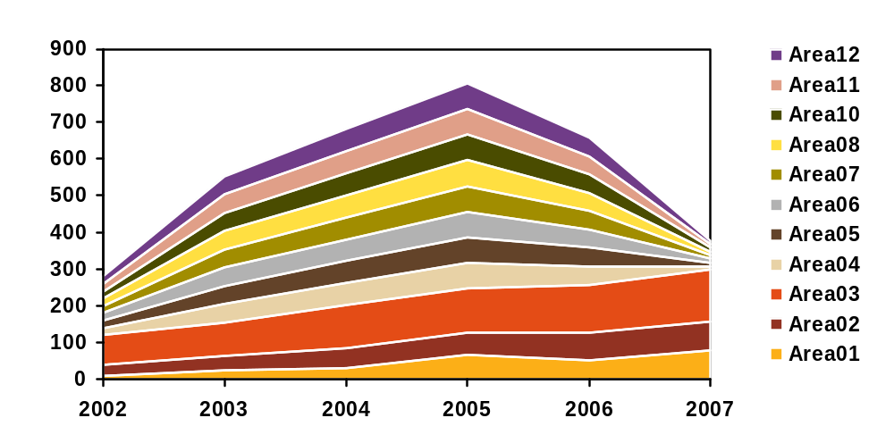
Chart Title
<number> | Presentation Title | Presenter Name | Date | Subject | Business Use Only

Slide 21
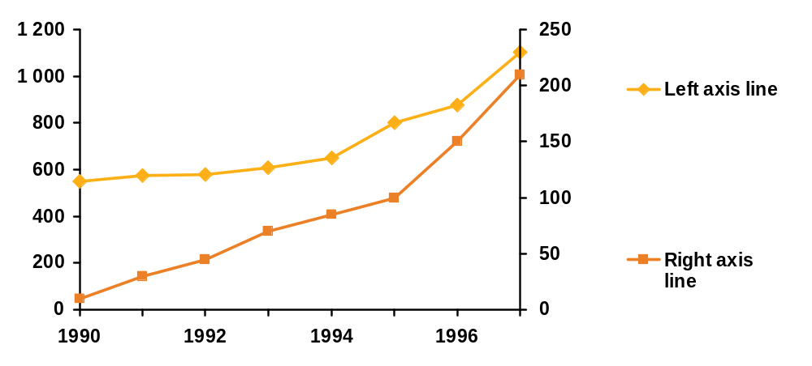
Chart Title
Axis Title
unit of measure
Axis Title
unit of measure
<number> | Presentation Title | Presenter Name | Date | Subject | Business Use Only

Slide 22
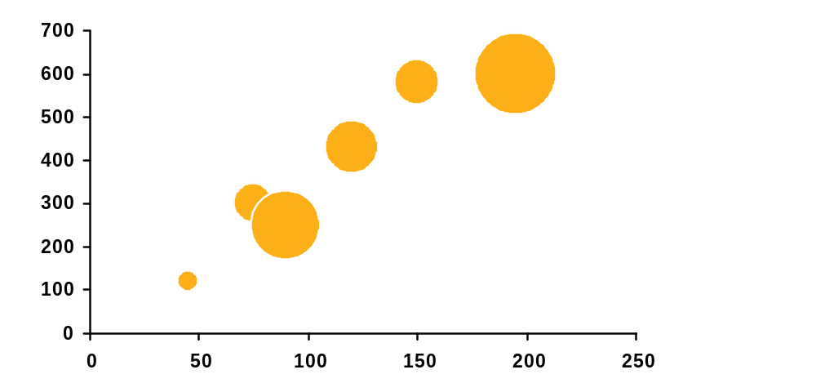
Chart Title
Axis Title
unit of measure
Axis Title
unit of measure
<number> | Presentation Title | Presenter Name | Date | Subject | Business Use Only

Slide 23
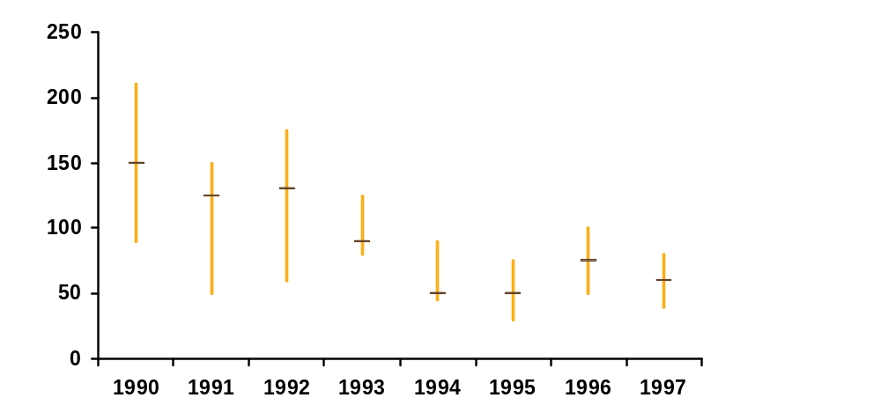
Chart Title
<number> | Presentation Title | Presenter Name | Date | Subject | Business Use Only

Slide 24
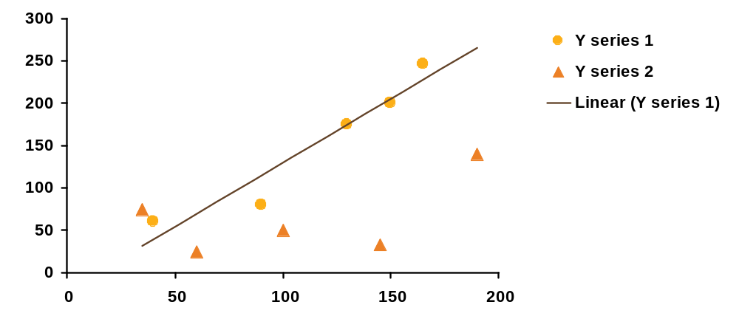
Chart Title
Axis Title
unit of measure
Axis Title
unit of measure
<number> | Presentation Title | Presenter Name | Date | Subject | Business Use Only

Slide 25
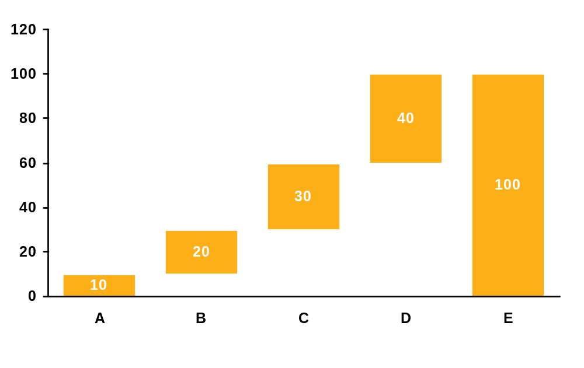
Chart Title
<number> | Presentation Title | Presenter Name | Date | Subject | Business Use Only

Slide 26
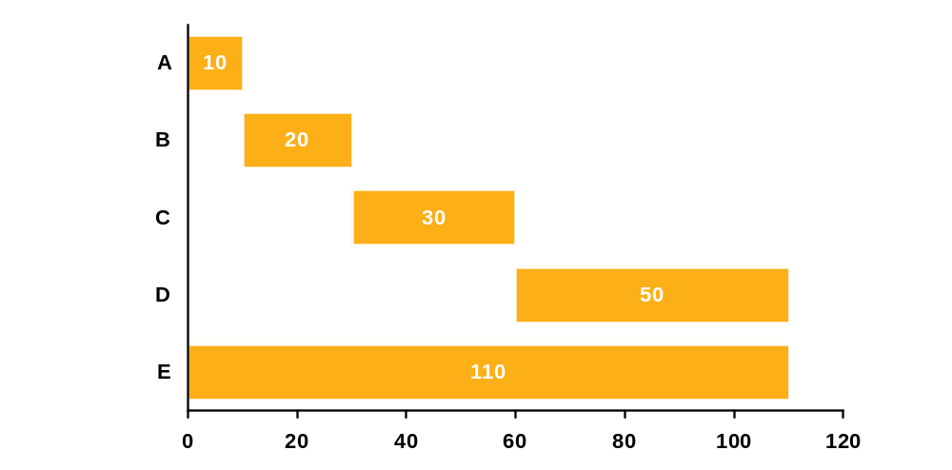
Chart Title
<number> | Presentation Title | Presenter Name | Date | Subject | Business Use Only

